Slide 1

NATURAL LANGUAGE PROCESSING
Twitter Topic Modeling:
#January6thCommitteeHearing
Created by: Jenni Hawk, October 2022

Slide 2



Introduction
Since Twitter is a major conversation platform for United States politics, The Washington Post would like to understand the topics that are trending within the January 6th Committee Hearings to get potential story ideas.

Slide 3

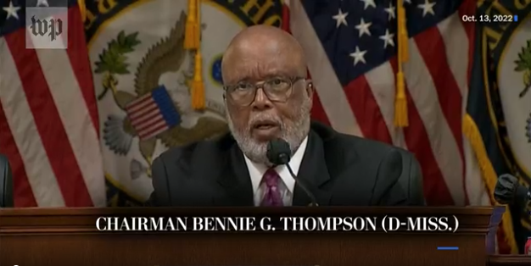
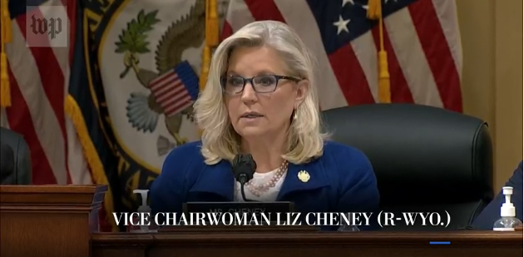
Key Questions
The January 6th Committee had a hearing on October 13th 2022 where they presented additional video evidence and voted to subpoena Trump.
What topics were most tweeted about during the Oct 13th hearing?
What was the primary topic associated with Trump?
What was the sentiment of the primary topic associated with Trump?
Notes:
https://www.washingtonpost.com/national-security/2022/10/13/jan-6-committee-hearings-live-updates/

Slide 4






Getting to Answers
35,000 Tweets + Retweets
Twitter API
Get Tweets
Preprocessing
Topic Modeling
Sentiment Analysis
Configured & Tested
Via Tweepy used Twitter API
Removed special chars, punctuation, etc
Unsupervised learning & rules-based approaches
Utilized VADER
Tweets pulled 10/14/22 at 1:15 Pacific Time

Slide 5
Topic Modeling

Slide 6
Methodology
Utilize a breadth of algorithms to uncover signals in the data that lead to human-understandable topics
LSA
LSA
LDA
LDA + Bigrams
Matrix Factorization utilizing SVD on the matrix of document terms
Matrix Factorization utilizing SVD on the matrix of document terms
Probabilistic Modeling describes documents by a distribution of word probabilities
Probabilistic Modeling & detect common phrases using Gensim’s ‘Phrases( )’
&
&
&
&
CountVectorizer
TF-IDF
CountVectorizer
Gensim simple_preprocess
Frequency of words in text
Considers words that are abundant in corpus as most statistically significant
Doesn’t identify relationships between words
Frequency of words in text AND
Inverse Document Frequency downscales words that appear a lot across documents
Helps in highlighting a word that is frequent in a document but not across documents
Frequency of words in text
Considers words that are abundant in corpus as most statistically significant
Doesn’t identify relationships between words
Similar to CountVectorizer but has some additional pre-process techniques to make it easier
Notes:
https://www.linkedin.com/pulse/count-vectorizers-vs-tfidf-natural-language-processing-sheel-saket/
https://machinehack.com/practices/general_ml/tfidf_vs_count_vectorizer_in_nlp
https://stackoverflow.com/questions/61055072/why-does-gensims-simple-preprocess-python-tokenizer-seem-to-skip-the-i-token

Slide 7
Matrix Factorization
Algorithm | Topic 1 Results | Topic 2 Results | Topic 3 Results | Topic 4 Results
LSA with CountVectorizer | trump, knew, responsible, called mcconnell, mccarthy, mitch kevin | trump, violence, democracy, mark attack, decided summoned, excuse | mark, democracy, gop, country maga, without, love, overthrowing | lost, stone, roger, video help, coup yet, new
LSA with TF-IDF | kevin, backed, mccarthy, mitch, mcconell, responsible, called knew | mark, democracy, violence, Hamill Creating, correct, overthrowing, love | decided, hatch, rudy, giuliani meadows, lost, yet, stone | demands, oath, unanimously, deserves history, voted, subpoeana
Probabilistic Modeling
Algorithm | Topic 1 Results | Topic 2 Results | Topic 3 Results | Topic 4 Results
LDA | knew, trump, pelosi, amp today, like, still, fbi | trump, knew, responsible, mcconnell called, mitch, backed, mccarthy, kevin | trump, maga, chris, thing national, miller, person, acting | Trump, lost, decided, attack, Coup, help, video, new
LDA with Bigrams | knew, trump, democracy, lost American_people, break, trump_tried, accept | trump, subpoena_donald, testify, voted_ unanimously demands, oath_democracy, history_deserves | trump, roger_stone, trump_lost, help yet, mark_meadows, decided, rudy_giuliani | called, mitch_ mcconnell, knew_ trump, responsible kevin_mccarthy, backed, thing
Notes:
Optimizations
Add these words to stop list: rt, january, january6thcommitteehearings, ja
Implement Bigrams with LDA
Analyze algorithm output, contextualize further by looking at tweets, and finalize topic names
Video Roger stone video
https://www.cnn.com/2022/09/26/politics/roger-stone-january-6-documentary-film/index.html
https://www.yahoo.com/news/video-shows-roger-stone-telling-065216462.html

Slide 8
Matrix Factorization
Algorithm | Topic Name | Topic Name | Topic Name | Topic Name
LSA with CountVectorizer | Mitch + Kevin Knew | Hamill for Democracy | Hamill for Democracy | Roger Stone Video
LSA with TF-IDF | Mitch + Kevin Knew | Hamill for Democracy | Trump Hatched Coup with Meadows, Guiliani, Stone | Subpoena Trump
Topic Names
Mitch + Kevin Knew Trump Responsible
Mark Hamill for Democracy – Against Trump
Trump Hatched Coup with Meadows, Guiliani, Stone
Probabilistic Modeling
Roger Stone Video
Algorithm | Topic Name | Topic Name | Topic Name | Topic Name
LDA | Not Clear Enough | Mitch + Kevin Knew | Not Clear Enough | Trump Lost Decided Attack
LDA with Bigrams | Not Clear Enough | Subpoena Trump | Trump Hatched Coup with Meadows, Guiliani, Stone | Mitch + Kevin Knew
Subpoena Trump
Trump Lost Decided Attack
Notes:
Optimizations
Add these words to stop list: rt, january, january6thcommitteehearings, ja
Implement Bigrams with LDA
Analyze algorithm output, contextualize further by looking at tweets, and finalize topic names
Video Roger stone video
https://www.cnn.com/2022/09/26/politics/roger-stone-january-6-documentary-film/index.html
https://www.yahoo.com/news/video-shows-roger-stone-telling-065216462.html

Slide 9
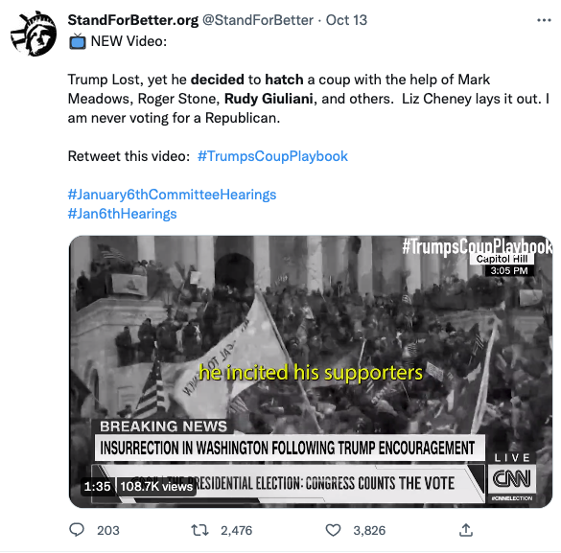
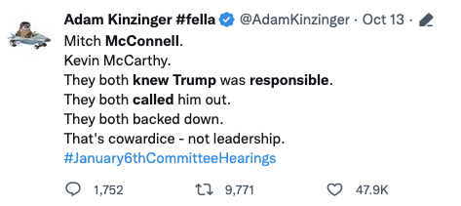
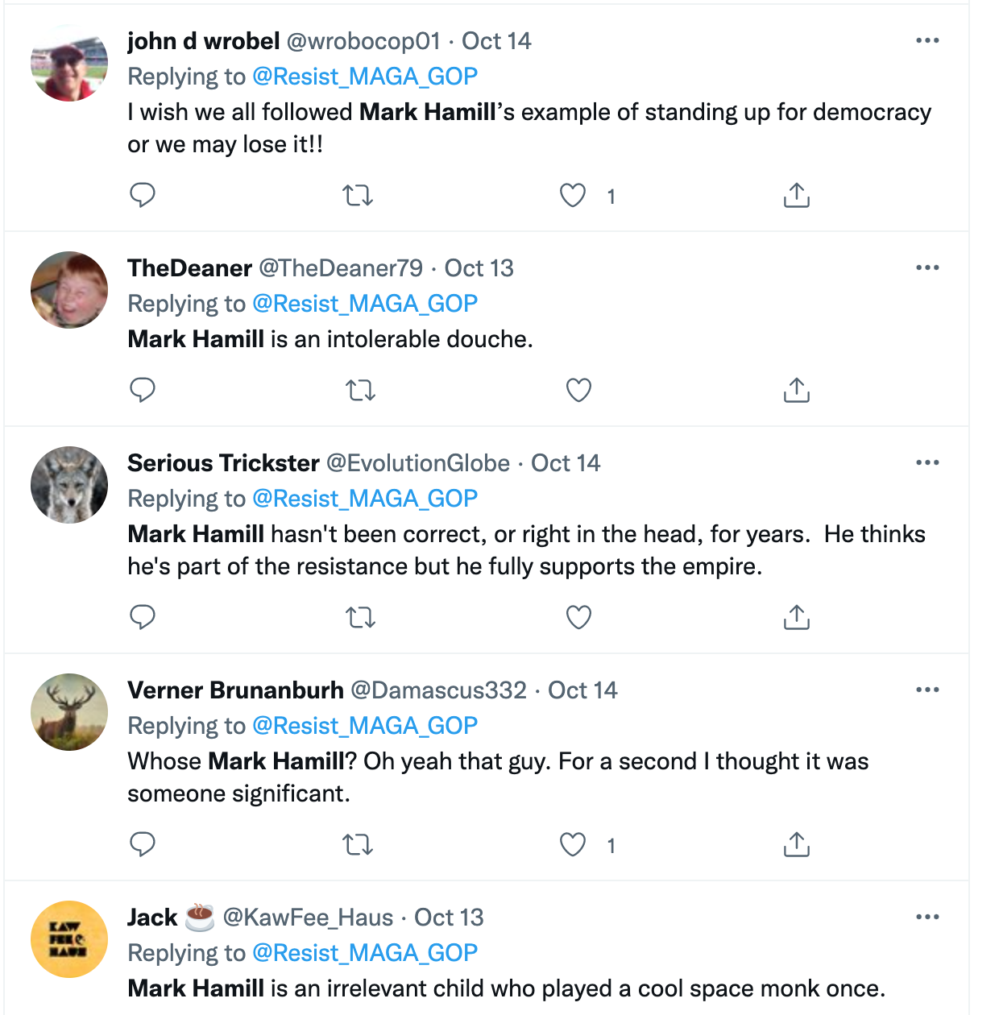
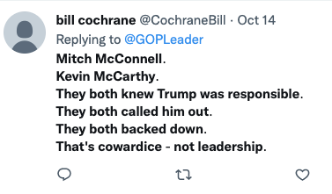
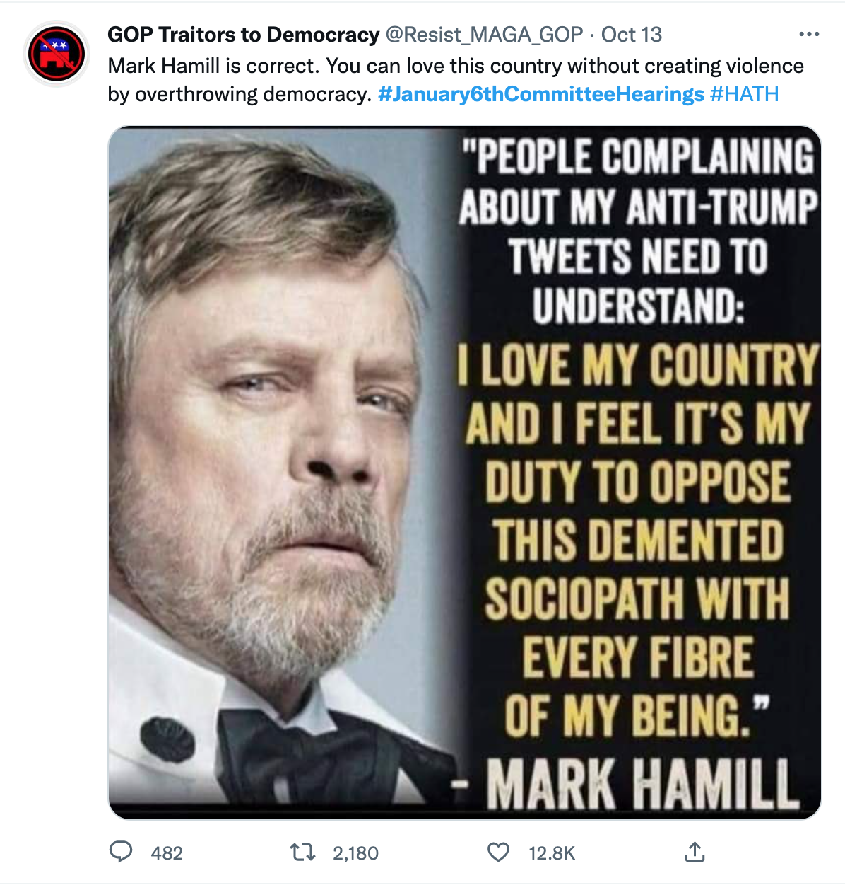
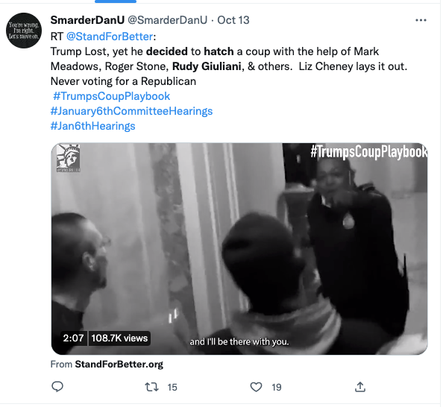
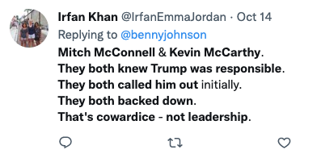
Mitch + Kevin Knew Trump Responsible
Mark Hamill for Democracy – Against Trump
Trump Hatched Coup with Meadows, Guiliani, Stone
Notes:
Mark Hamill: The algorithms are leaning into
https://www.youtube.com/watch?v=UEn3xHNBXJU

Slide 10
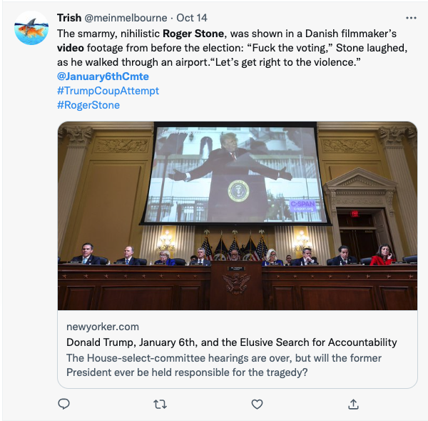
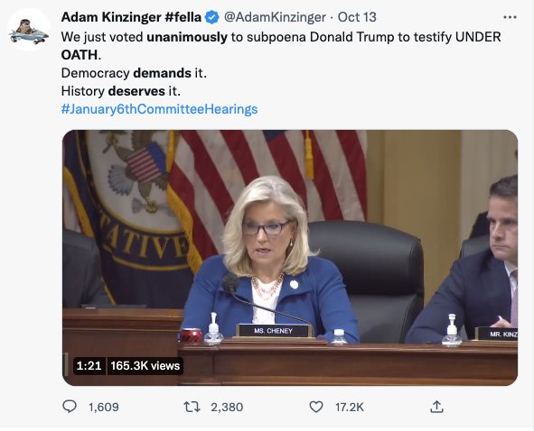
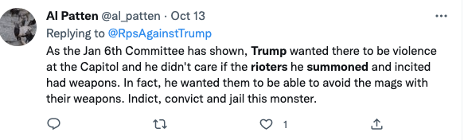
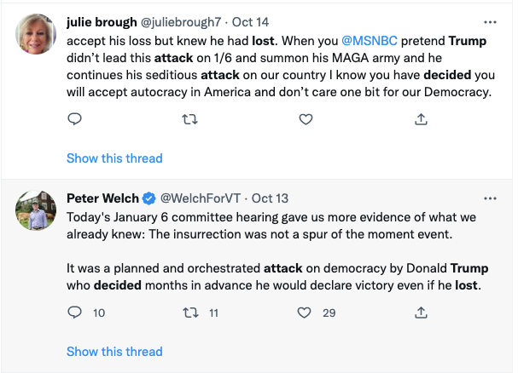
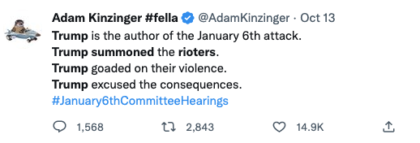
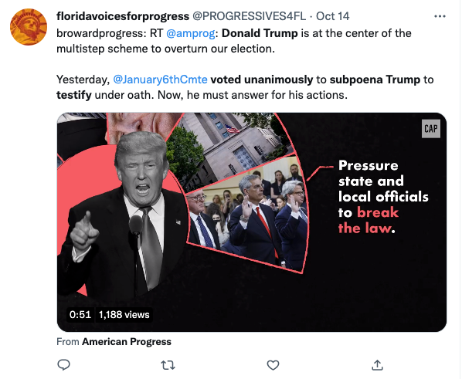
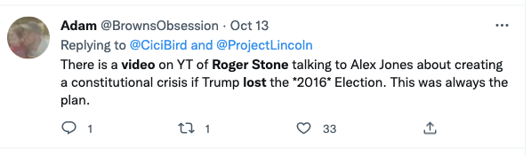
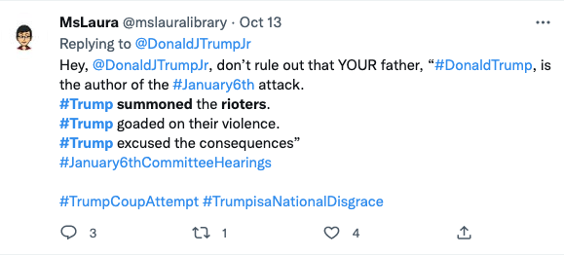
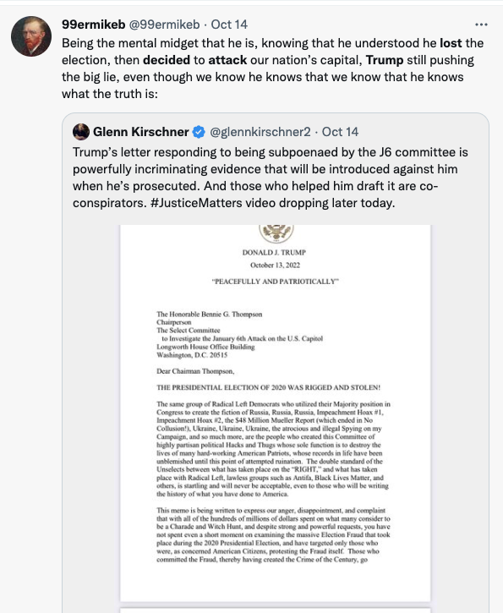
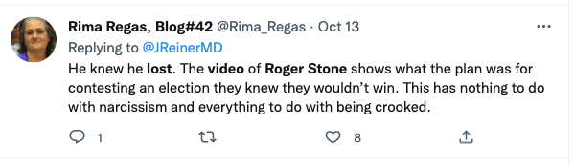
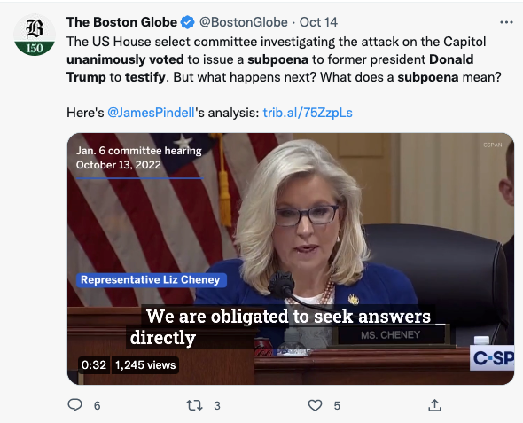
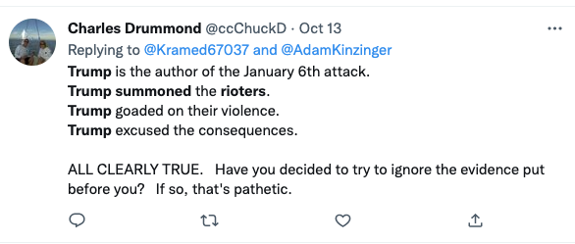
Roger Stone Video
Subpoena Trump
Trump Summoned Rioters
Trump Lost Decided Attack
Notes:
https://www.youtube.com/watch?v=UEn3xHNBXJU

Slide 11
Sentiment
When looking at the conversation captured in its entirety

Slide 12
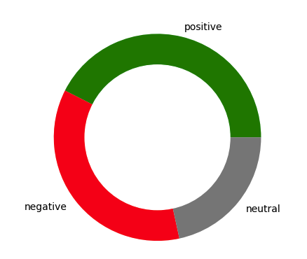
Is VADER Sentiment making sense given the context of the conversation?
Themes of negative conversation seem clear
Positive conversation seems murky
Prompts the question: Is the positive sentiment really a positive conversation?
Tweet | Neg/Pos | Compound Score
TRUMP LOST, KNEW HE LOST! You maga fools are all party to effin Treason | Neg | -0.88
ANGRY ANGRY ANGRY. It's way beyond bourbon | Neg | -0.87
Keep wasting time and money losers January6thCommitteeHearings | Neg | -0.72
Ugh. This shit again | Neg | -0.75
Hooooooooly shit | Neg | -0.55
Fuck Fox News | Neg | -0.54
Distraction 101 | Neg | -0.38
wow wow trumpisgoingtojail capitolriot nancypelos | Pos | 0.82
Justice & Peace | Pos | 0.78
Stunning. Stunning. Stunning. Stunning | Pos | 0.85
Treat Trump like the Rosenbergs | Pos | 0.63
Too funny 😂 #January6thCommitteeHearings | Pos | 0.44
Interesting | Pos | 0.40
Joke | Pos | 0.29
Notes:
eg: wow and stunning are not meant in a positive way

Slide 13
Thanks for Listening

